Slide 1
Insider Trading

Slide 2

Introduction to Insider Trading
Insider trading refers to the buying or selling of a publicly-traded company's stock based on non-public, material information.
It is illegal in most jurisdictions as it undermines investor confidence in the fairness and integrity of the securities markets.
Understanding insider trading is essential for recognizing its implications on market dynamics and legal consequences.
Notes:
Image source: http://forexwot.com/what-is-stocks-insider-trading.html

Slide 3
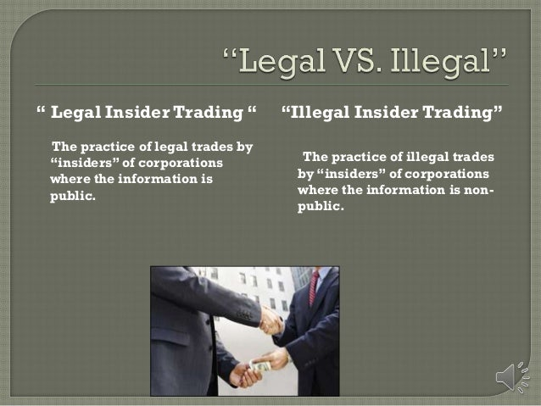
Types of Insider Trading
Legal insider trading occurs when corporate insiders buy or sell stock in their own companies, following proper reporting procedures.
Illegal insider trading involves executives or employees trading based on confidential information not available to the general public.
The distinction between legal and illegal insider trading is crucial for maintaining ethical investment practices.
Notes:
Image source: https://www.slideshare.net/terrycoulon/insider-trading-27509621

Slide 4
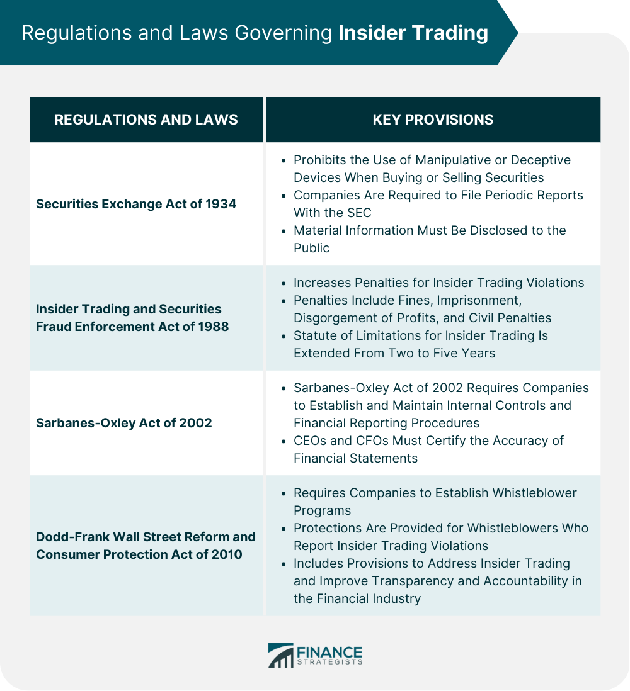
Legal Framework
Insider trading is governed by securities laws and regulations enforced by agencies like the Securities and Exchange Commission (SEC) in the United States.
Laws require insiders to report their trades to promote transparency and deter unlawful practices.
Violations can lead to severe penalties, including fines and imprisonment for those found guilty of illegal trading.
Notes:
Image source: https://www.financestrategists.com/wealth-management/insider-trading/

Slide 5
Consequences of Insider Trading
Individuals caught engaging in illegal insider trading can face hefty fines, often up to three times the profit gained or loss avoided.
Criminal charges can result in imprisonment, with sentences varying based on the severity of the offense.
Companies may suffer reputational damage, leading to a loss of investor trust and potentially impacting stock prices.
Notes:
Image source: https://medium.com/@gargiben954/insider-trading-uncovering-the-illegal-practice-and-its-consequences-3ccb24acb7f3

Slide 6
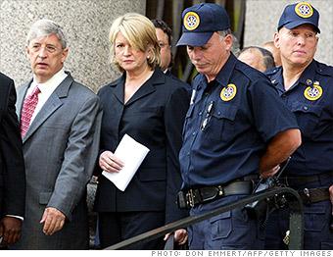
High-Profile Cases
Some notable insider trading cases include the Martha Stewart case and the Raj Rajaratnam case, both garnering significant media attention.
These cases highlighted the enforcement of insider trading laws and the severe repercussions for those involved.
High-profile prosecutions serve as cautionary tales for potential offenders in the financial markets.
Notes:
Image source: http://money.cnn.com/gallery/investing/2014/06/02/insider-trading-famous-cases/index.html

Slide 7
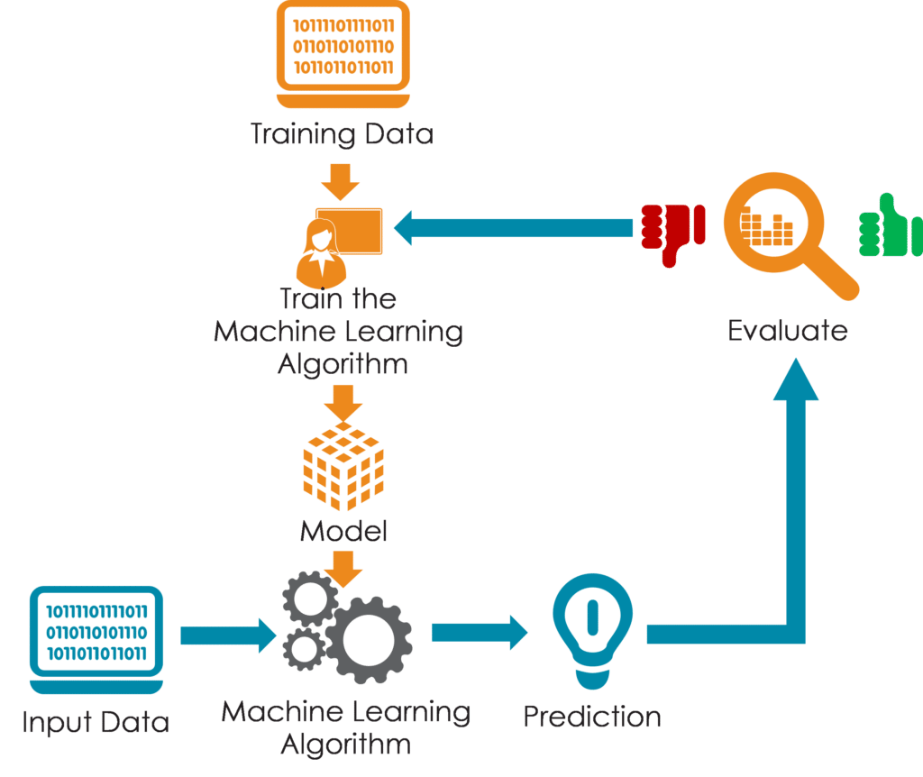
Detecting Insider Trading
Regulators utilize sophisticated algorithms and surveillance systems to identify unusual trading patterns indicative of insider trading.
Tips from whistleblowers and industry insiders also play a crucial role in uncovering potential illegal activities.
Ongoing monitoring of trading activity helps ensure compliance with insider trading laws and regulations.
Notes:
Image source: https://intellipaat.com/blog/tutorial/data-science-tutorial/modeling-the-data/

Slide 8
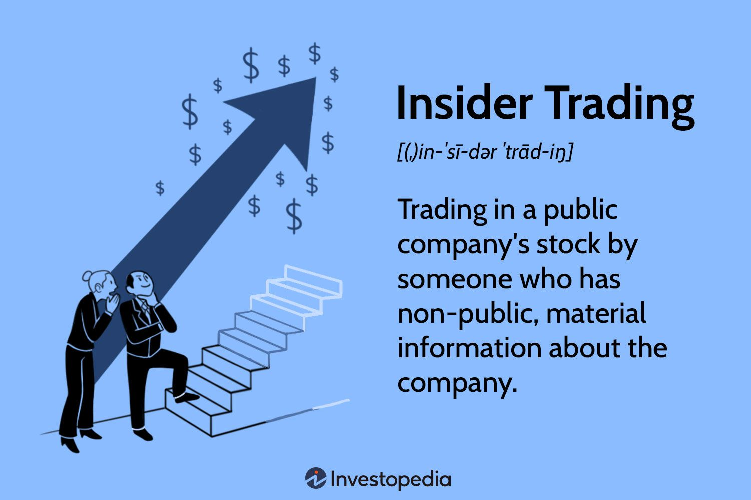
Impact on Markets
Insider trading can distort market integrity by creating an uneven playing field for investors.
It can lead to volatility in stock prices, as information asymmetry influences trading behaviors.
Overall, insider trading erodes trust in the financial system, which can have long-term detrimental effects on market performance.
Notes:
Image source: https://www.wlp.com.sg/what-is-insider-trading/

Slide 9
Mitigating Insider Trading Risks
Companies can implement strict internal policies and training programs to educate employees about the legal implications of insider trading.
Establishing clear communication channels for reporting suspicious activities can help deter potential violations.
Regular audits and compliance checks are essential in maintaining adherence to insider trading laws and ensuring ethical business practices.
Notes:
Image source: https://simeononsecurity.com/articles/insider-threat-indicators-and-identifying-potential-risk/

Slide 10

Role of Whistleblowers
Whistleblowers play a critical role in exposing insider trading by reporting unethical behavior to regulatory authorities.
Many jurisdictions provide legal protections and incentives for whistleblowers to encourage the reporting of insider trading.
Effective whistleblower programs can help identify and address insider trading before it escalates into larger legal issues.
Notes:
Image source: https://www.whistlelink.com/blog/the-role-of-whistleblowers-in-companies-organisations-and-society/

Slide 11
Conclusion and Future Outlook
Insider trading remains a significant concern for regulators, investors, and companies alike in maintaining a fair market environment.
Ongoing advancements in technology may enhance detection capabilities but will also require constant evolution of regulations.
The future of insider trading enforcement will depend on the commitment of all market participants to uphold ethical standards and legal compliance.
Notes:
Image source: https://ar.inspiredpencil.com/pictures-2023/insider-trading

